Slide 1
Closing of Colleges Model
By Juan Garcia

Slide 2
What the project is about
This model takes in data from a lot of different colleges and universities and sees if there’s a pattern on why they closed and if it can be predicted, or if there are any patterns that I can model.

Slide 3
Why I’m doing this project
This project sounded interesting to me because I feel like after COVID-19, and the huge amount of colleges that are closing, I think is a good idea for students and others to know if their school is possibly going to go under, or if there’s the possibility that their schools of that they are about to attend don’t have great financials which could reflect the number of opportunities that the college can offer.

Slide 4
Narrowing my problem down:
At the start I wanted to create a model that would say when wofford would go under, or how could wofford go under, but I felt like that was very challenging as I couldn’t find a lot of data specifically about wofford. I then decided to go broader and see if all of the colleges that have closed had anything in common, and if so does that thing in common correlate with them going under.

Slide 5
Beginning Research
At the beginning of my research I struggled with finding good reliable data. I first decided to include some random colleges that had closed down then research them individually to find out their different reasons for closing and trying to look at their finance etc..
This data was very hard to find but then I was able to find studentaid.gov
I went to studentaid.gov which had data on composite scores that let people know whether a school is financially responsible or not.

Slide 6
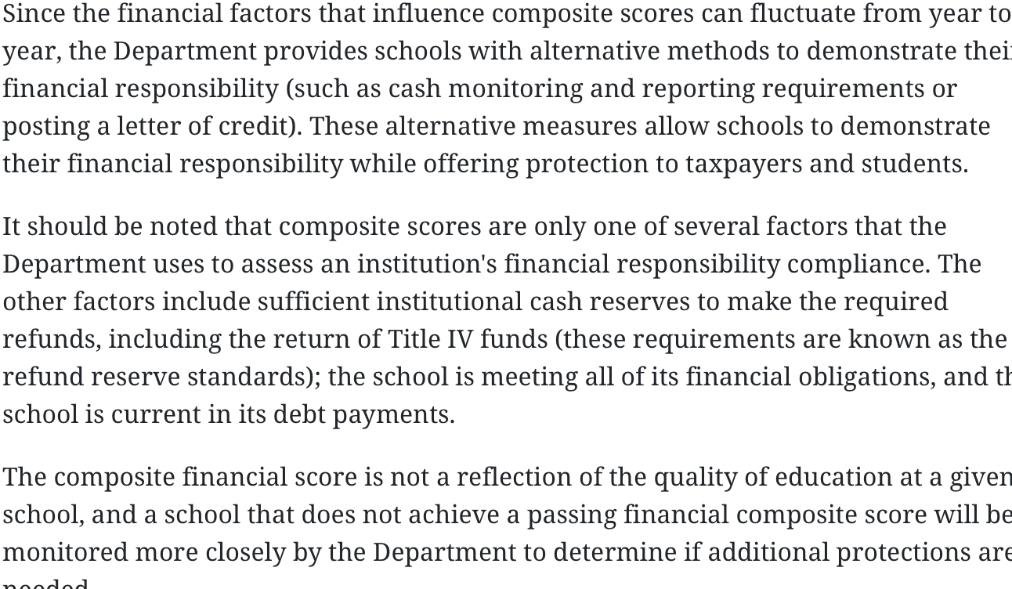
What the composite score means
The composite score is just a number that is given to institutions. The number depends on how financially stable a college is, but studentaid.gov did mention that this is not a reflection of the quality of education and that there are certain things that they didn’t take into account for the composite scores
I still found the scores very interesting and wanted to see any correlation between them and schools that had closed down.
For the scores if the score is < 3 then the school is financially good but still has some things to take care of, if is < 2 then is still financially stable but needs to show improvement the next year, if is <1 then the school is not financially stable

Slide 7
Finding Closed schools data:
My next step was to figure out where to get a lot of closed schools data that already had the composite score and other needed information ready. I was also able to find all of the colleges and universities that have closed down in the past 2 decades.

Slide 8
Organizing and cleaning the data
To be able to have more control over the data and be able to see the patterns I decided to limit my data to schools that thad closed down from 2019 all the way to 2022.
I also decided to do the composite scores for the past 5 years to see any correlation.
After cleaning the data I found out that a lot of schools didn’t have composite scores for some years so I had to make sure to get rid of that data so that it didn’t mess up the calculations.

Slide 9
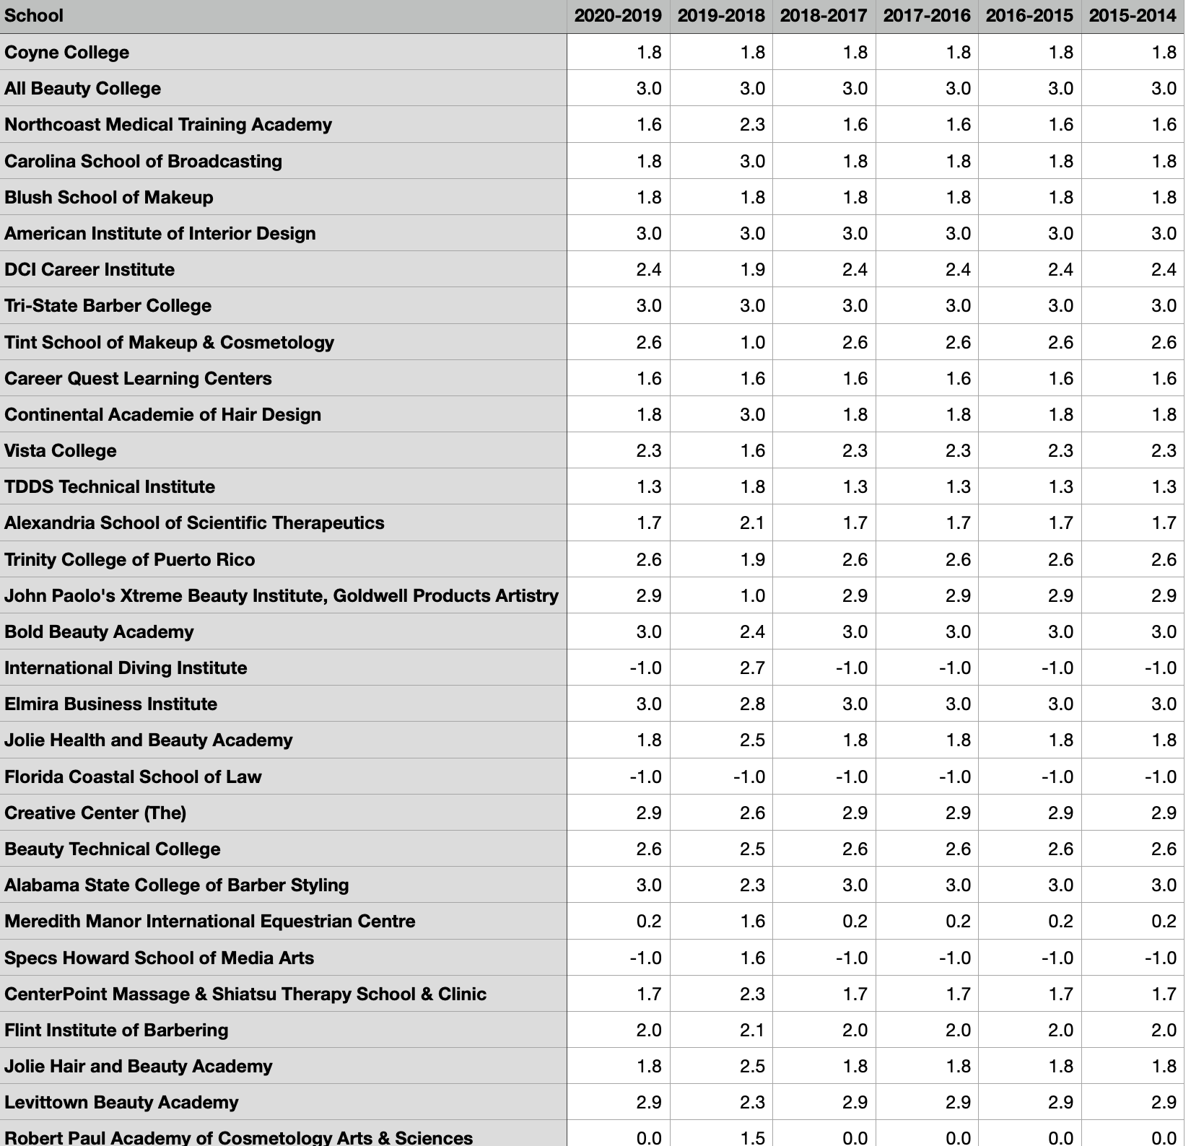
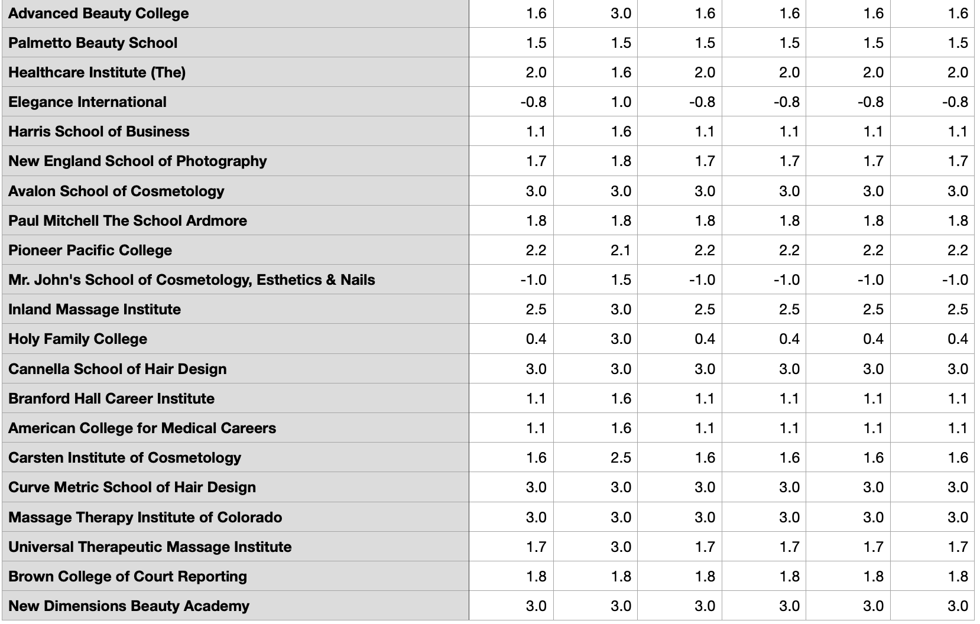

Slide 10
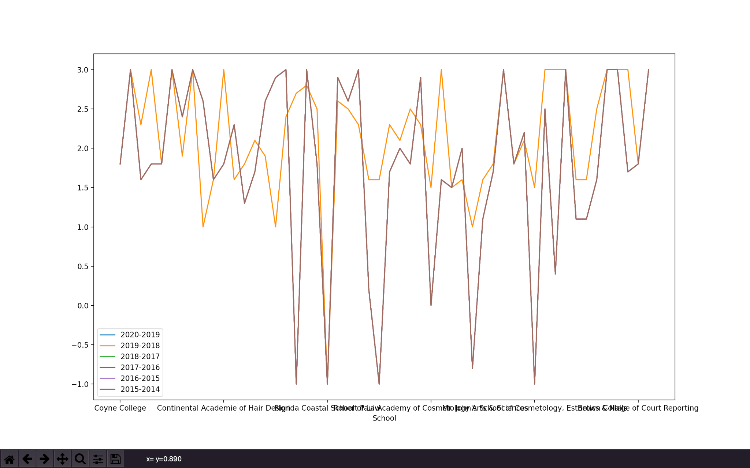
After Data Cleaning:
After cleaning the Data I created a graph to see if I can find anything that shows a correlation between Composite Scores and colleges closing.

Slide 11
Interpreting The Results:
When looking at the graph I notice that The scores are all fairly the same throughout the years, meaning that they are pretty constant for all schools. But during the 2018-2019 year there was a change. Which makes sense as that’s when covid 19 happened. The scores during that time look like they went lower.

Slide 12
Comparing Results:
https://tuitiontracker.org/fitness/index.html - this websites tracks the “Fitness” of an institution, it uses public information on schools and data to figure out the financial fitness of an institution. Because schools take a while to release data they estimate what the scores would be in the future.
When compared to my model and results they were very similar, except for 3/10 of the cases where my results were off.

